Slide 1
CSCI-351 Data communication and Networks
Lecture 10: Inter Domain Routing
(It’s all about the Money)
The slide is built with the help of Prof. Alan Mislove, Christo Wilson, and David Choffnes's class

Slide 2
Network Layer, Control Plane
Function:
Set up routes between networks
Key challenges:
Implementing provider policies
Creating stable paths
Data Plane
Application
Presentation
Session
Transport
Network
RIP
OSPF
BGP
Control Plane
Data Link
Physical

Slide 3



ASs, Revisited
AS-1
AS-3
Interior Routers
AS-2
BGP Routers

Slide 4
AS Numbers
Each AS identified by an ASN number
16-bit values (latest protocol supports 32-bit ones)
64512 – 65535 are reserved
Currently, there are > 20000 ASNs
AT&T: 5074, 6341, 7018, …
Sprint: 1239, 1240, 6211, 6242, …
Northeastern: 156
North America ASs → ftp://ftp.arin.net/info/asn.txt

Slide 5
Inter-Domain Routing
Global connectivity is at stake!
Thus, all ASs must use the same protocol
Contrast with intra-domain routing
What are the requirements?
Scalability
Flexibility in choosing routes
Cost
Routing around failures
Question: link state or distance vector?
Trick question: BGP is a path vector protocol

Slide 6
BGP
Border Gateway Protocol
De facto inter-domain protocol of the Internet
Policy based routing protocol
Uses a Bellman-Ford path vector protocol
Relatively simple protocol, but…
Complex, manual configuration
Entire world sees advertisements
Errors can screw up traffic globally
Policies driven by economics
How much $$$ does it cost to route along a given path?
Not by performance (e.g. shortest paths)

Slide 7
BGP Relationships
Provider
Peer 2 has no incentive to route 1→ 3
Peers do not pay each other
Customer
Provider
Customer
Peer 1
Peer 2
Peer 3
Customer pays provider
Customer

Slide 8
Tier-1 ISP Peering
Inteliquent
Centurylink
Verizon Business
AT&T
Level 3
Sprint
XO Communications

Slide 9
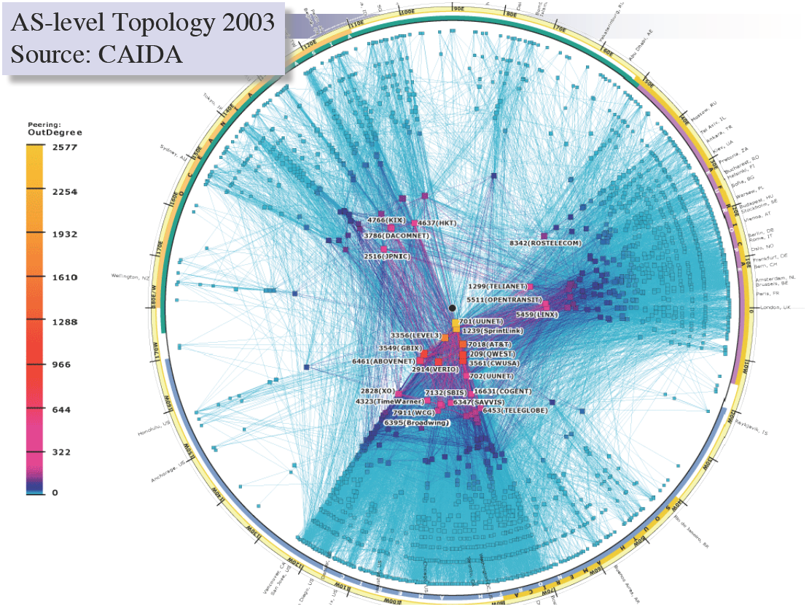

Slide 10
Peering Wars
Peer
Don’t Peer
Reduce upstream costs
Improve end-to-end performance
May be the only way to connect to parts of the Internet
You would rather have customers
Peers are often competitors
Peering agreements require periodic renegotiation
Peering struggles in the ISP world are extremely contentions, agreements are usually confidential

Slide 11
Two Types of BGP Neighbors
Exterior routers also speak IGP
IGP
eBGP
eBGP
iBGP
iBGP

Slide 12
Full iBGP Meshes
Question: why do we need iBGP?
OSPF does not include BGP policy info
Prevents routing loops within the AS
iBGP updates do not trigger announcements
eBGP
iBGP

Slide 13
Path Vector Protocol
AS-path: sequence of ASs a route traverses
Like distance vector, plus additional information
Used for loop detection and to apply policy
Default choice: route with fewest # of ASs
AS 4
120.10.0.0/16
AS 3
130.10.0.0/16
AS 5
AS 2
110.10.0.0/16
120.10.0.0/16: AS 2 → AS 3 → AS 4
130.10.0.0/16: AS 2 → AS 3
110.10.0.0/16: AS 2 → AS 5
AS 1

Slide 14
BGP Operations (Simplified)
Establish session on TCP port 179
AS-1
Exchange active routes
BGP Session
AS-2
Exchange incremental updates

Slide 15
Four Types of BGP Messages
Open: Establish a peering session.
Keep Alive: Handshake at regular intervals.
Notification: Shuts down a peering session.
Update: Announce new routes or withdraw previously announced routes.
announcement = IP prefix + attributes values

Slide 16
BGP Attributes
Attributes used to select “best” path
LocalPref
Local preference policy to choose most preferred route
Overrides default fewest AS behavior
Multi-exit Discriminator (MED)
Specifies path for external traffic destined for an internal network
Chooses peering point for your network
Import Rules
What route advertisements do I accept?
Export Rules
Which routes do I forward to whom?

Slide 17
Route Selection Summary
18
Highest Local Preference
Enforce relationships
Shortest AS Path
Lowest MED
Traffic engineering
Lowest IGP Cost to BGP Egress
When all else fails,
break ties
Lowest Router ID

Slide 18
Shortest AS Path != Shortest Path
4 hops
4 ASs
9 hops
2 ASs
Source
?
?
Destination

Slide 19
Hot Potato Routing
5 hops total, 2 hops cost
Source
3 hops total,
3 hops cost
?
?
Destination

Slide 20
Importing Routes
From Provider
ISP Routes
From Peer
From Peer
From Customer

Slide 21
Exporting Routes
$$$ generating routes
Customer and ISP routes only
To Provider
To Peer
To Peer
To Customer
Customers get all routes

Slide 22

Modeling BGP
AS relationships
Customer/provider
Peer
Sibling, IXP
Gao-Rexford model
AS prefers to use customer path, then peer, then provider
Follow the money!
Valley-free routing
Hierarchical view of routing (incorrect but frequently used)
P-P
P-P
C-P
P-C
P-C
P-P

Slide 23
AS Relationships: It’s Complicated
GR Model is strictly hierarchical
Each AS pair has exactly one relationship
Each relationship is the same for all prefixes
In practice it’s much more complicated
Rise of widespread peering
Regional, per-prefix peerings
Tier-1’s being shoved out by “hypergiants”
IXPs dominating traffic volume
Modeling is very hard, very prone to error
Huge potential impact for understanding Internet behavior

Slide 24
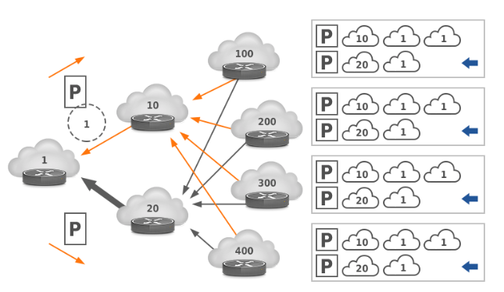
Other BGP Attributes
AS_SET
Instead of a single AS appearing at a slot, it’s a set of Ases
Why?
Prepending
Lengthening the route by adding multiple instances of ASN
Why?
Notes:
AS1 := 10.1.0.0/24
|
AS2 := 10.1.2.0/23 —> Combine AS1 + AS3: 10.1.0.0/23
|
AS3 := 10.1.1.0/24

Slide 25
Security Challenges?
Any AS can announce ANY IP prefixes

Slide 26
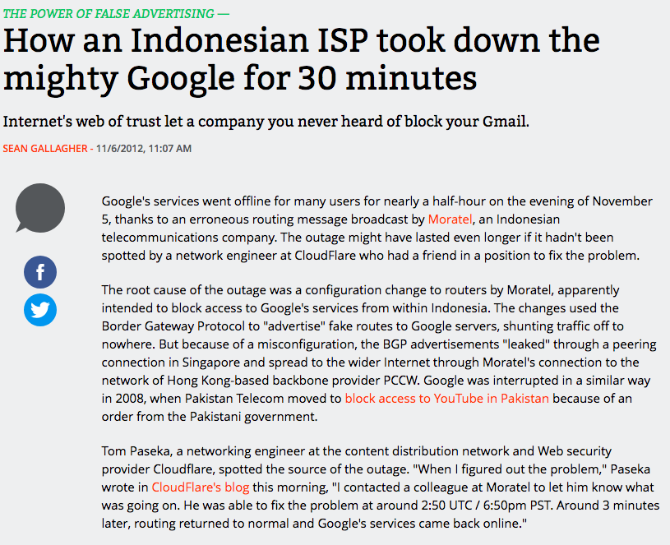

Slide 27
